Slide 1

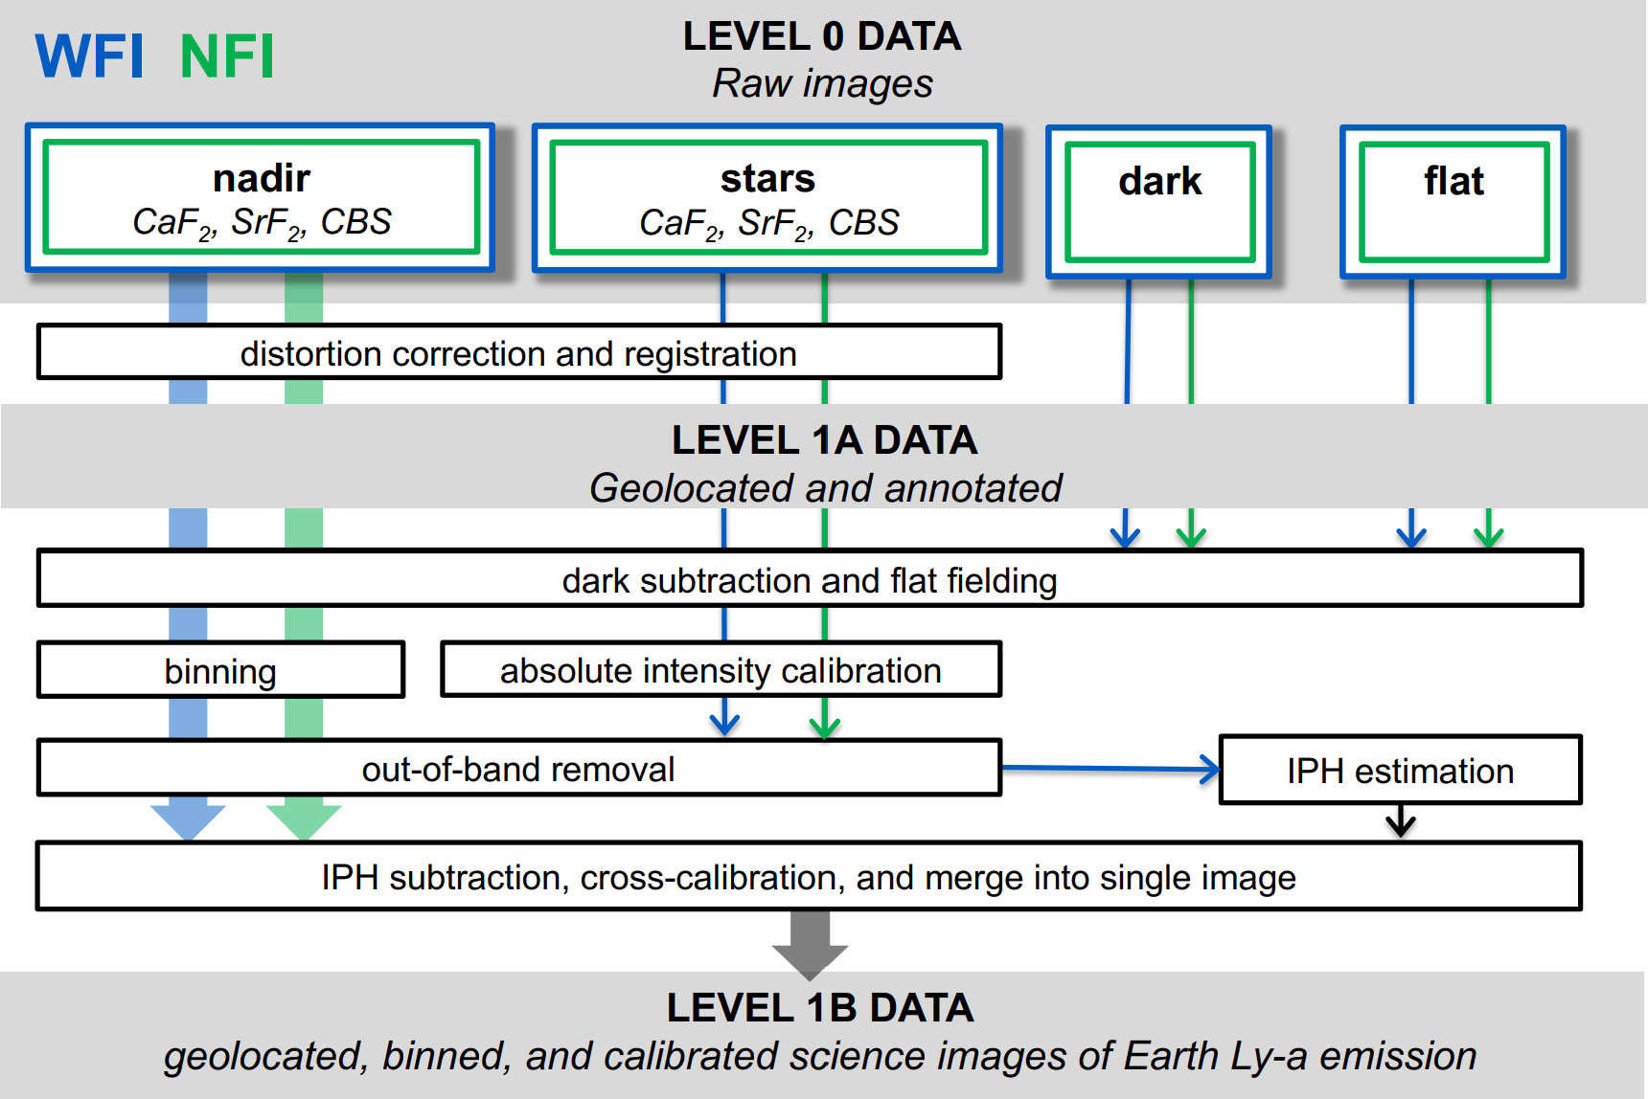
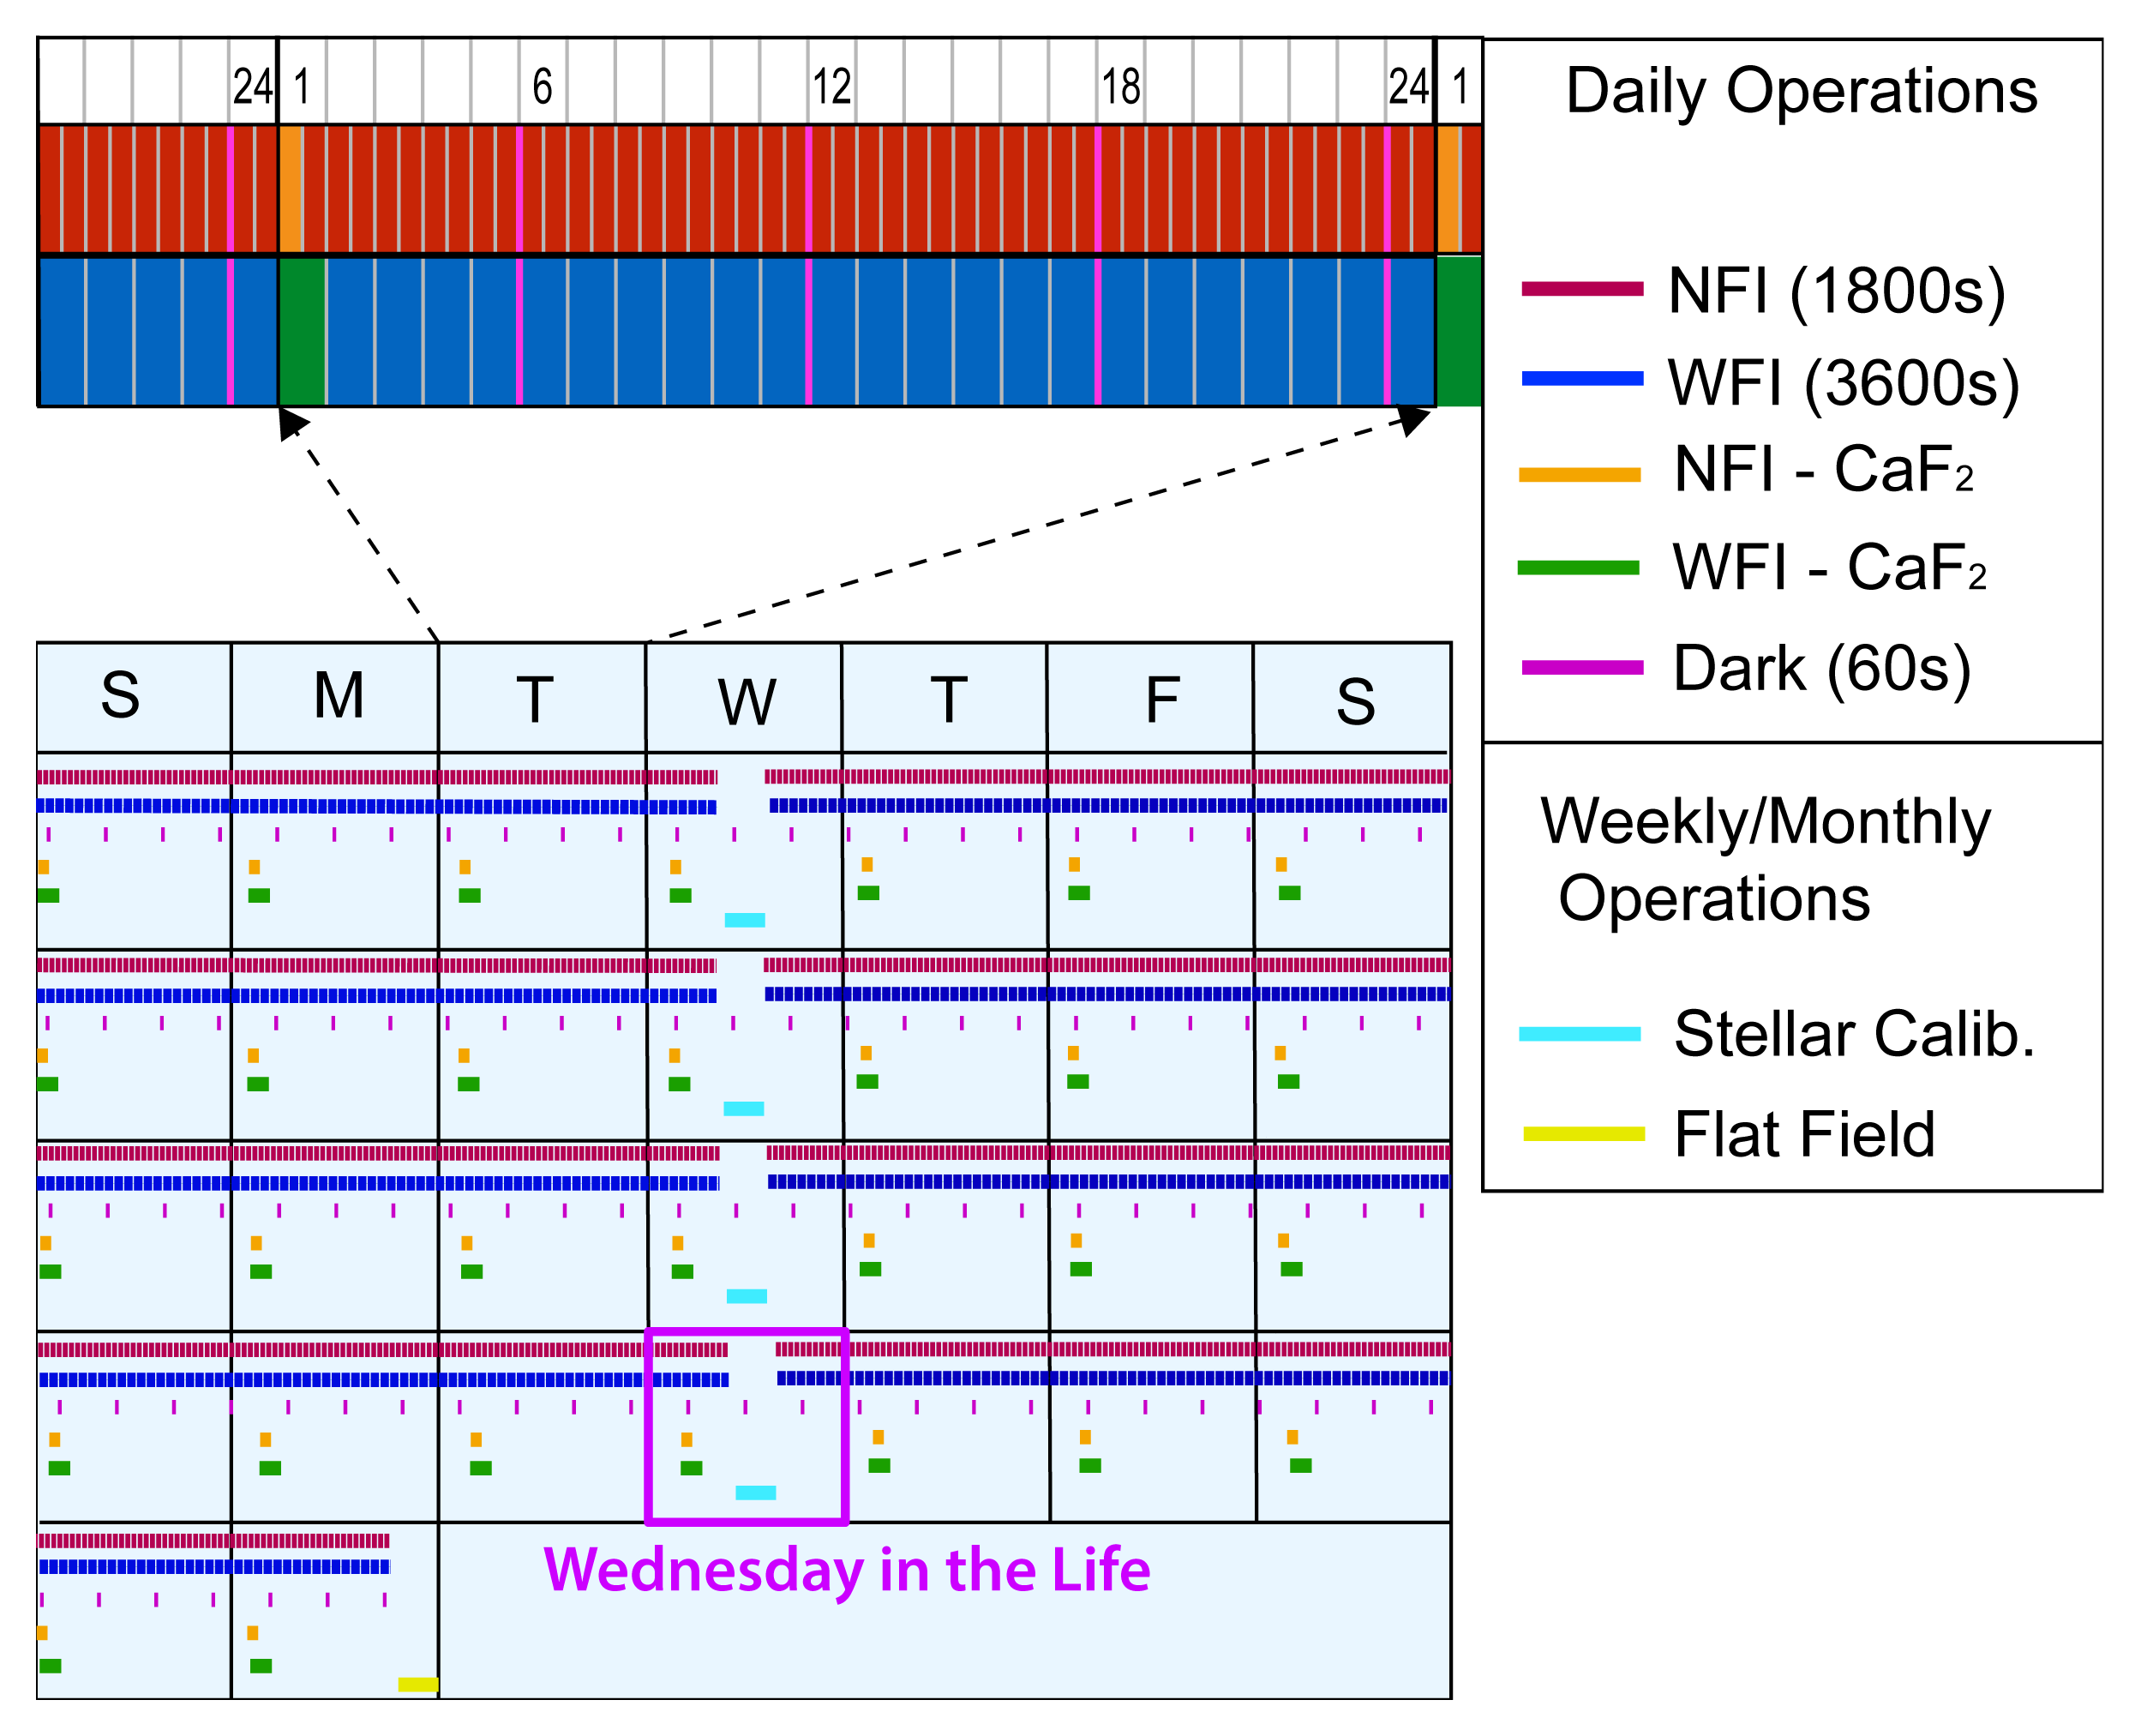
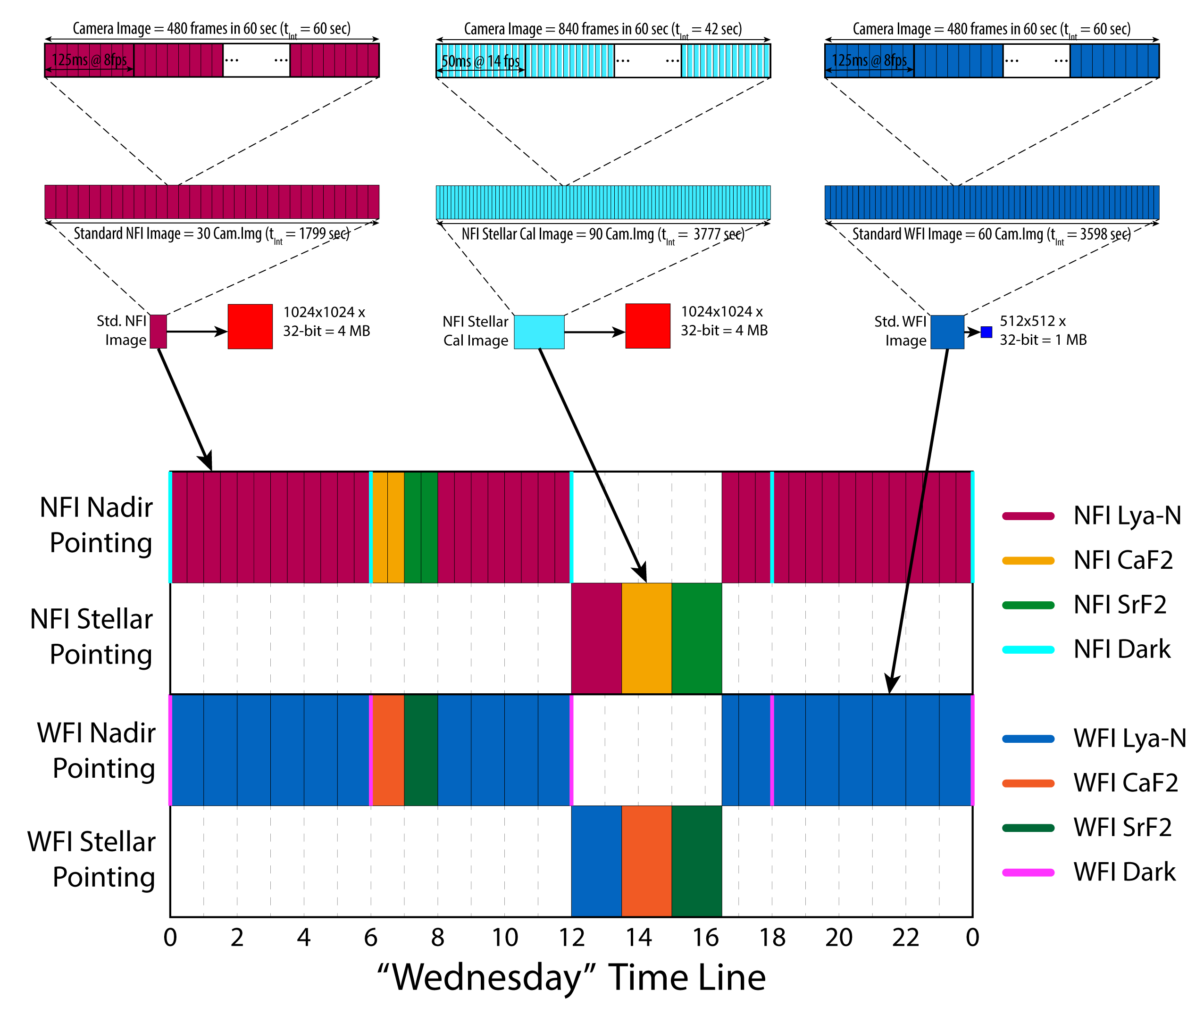
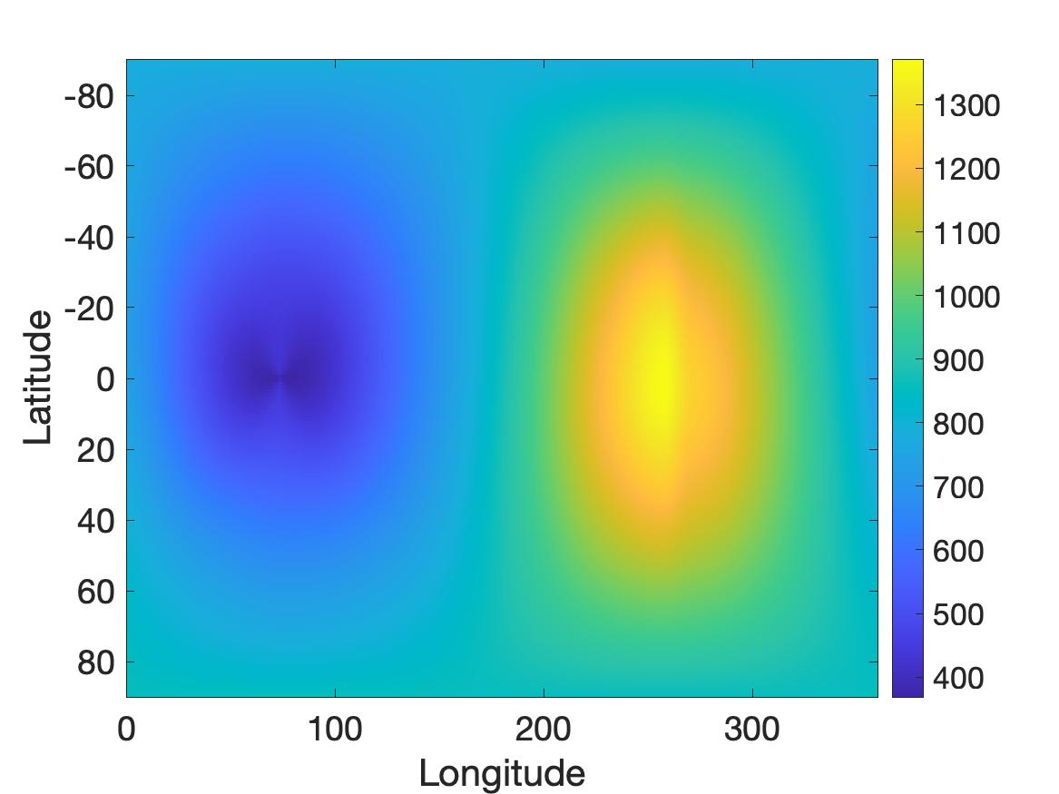
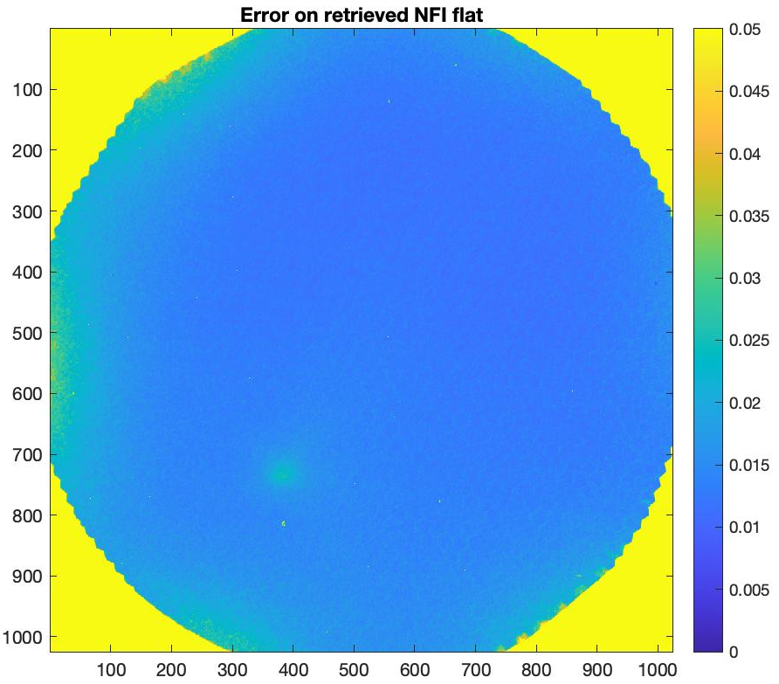
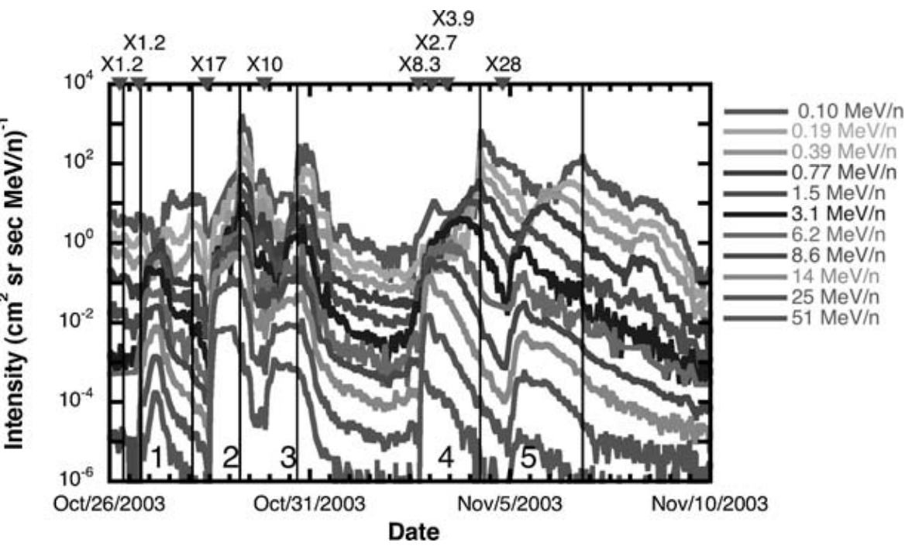
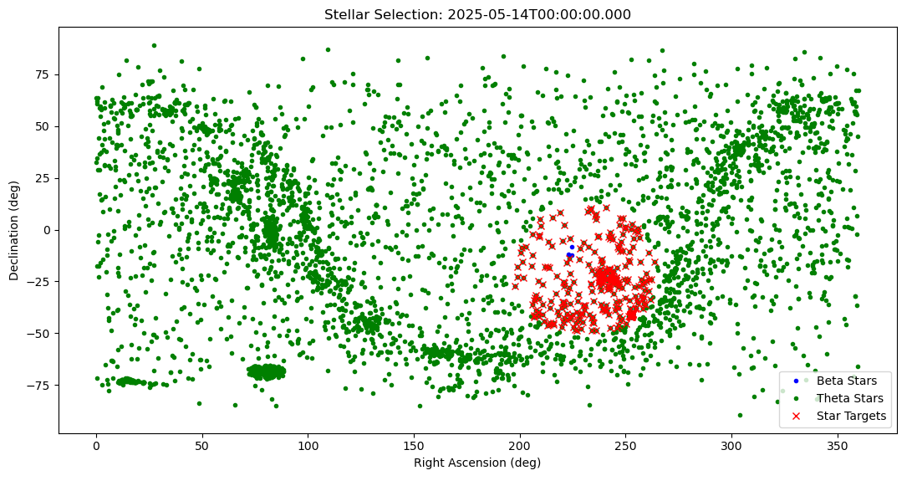
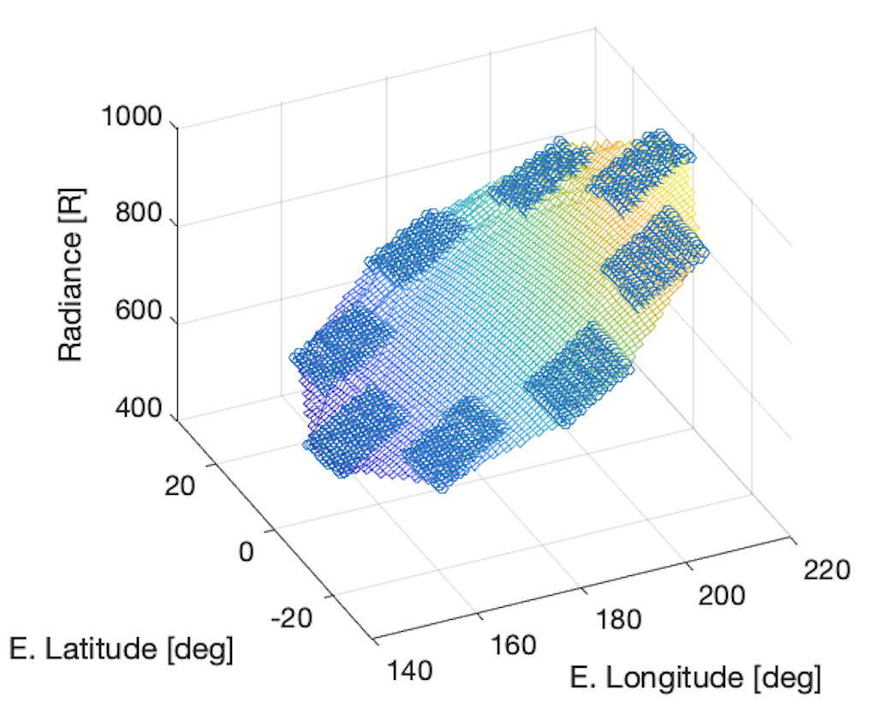
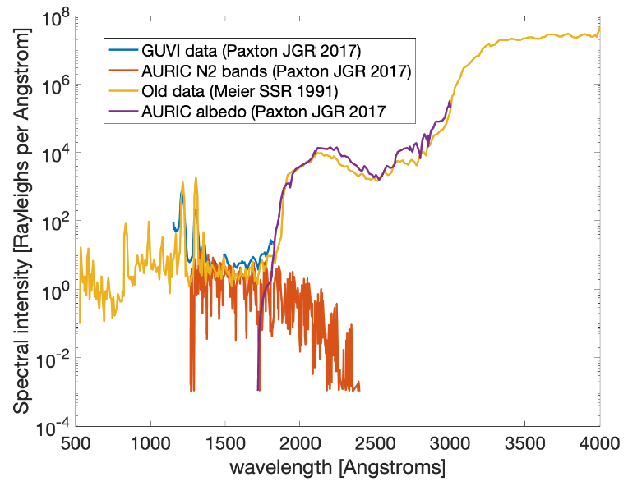






CARRUTHERS GEOCORONA OBSERVATORY
On-Orbit Calibration Pipeline
Alex Zhang (ECE senior thesis student)
Calibration Schedule Of Operations
Calibration Data Processing Pipeline
Dark frames 8x daily using blocking filter
Out-of-band frames daily (on-nadir) using CaF₂ and SrF₂ filters
Stellar frames weekly using all filters (slew to target and stare)
Flat-field frames monthly using open filter (slew, stare, roll)
Instrument Background (Dark + Particle Radiation)
Flat-Field Retrieval
Instrument (non-photon) background is comprised of:
Detector dark current
Particle radiation directly on the APS silicon detector
Gain-intensified particle radiation on the MCP (within the illuminated field-of-view only)
All sources are measured in the dark images every 3-hrs
The first two sources are measured in the non-illuminated corners of each science image (every 30-60 minutes)
CGO will be able to determine instrument background accurately, even during time-varying solar storm events
The flat-field characterizes variations in optical sensitivity across the instrument field-of-view. We measure it using the smooth distribution of interplanetary H emission known as the IPH
Flat field images are acquired monthly along a common off-nadir boresight at 4 roll angles separated by 90º
s/c
roll
Retrieval error using
synthetic + lab data is < 5%
Science
Field-of-View
common boresight
IPH emission radiance distribution
Halloween 2003 Storm Radiation
Stellar Calibration
Photon Background (In-Band and Out-Of-Band)
exospheric
Lyman-alpha
emission line
In-band (IPH) background is measured around the perimeter of the exosphere during the initial on-orbit checkout phase and in the outer annulus of every WFI science image for interpolation onto exospheric lines-of-sight
Out-of-band signals from O and N₂ emission contaminate science data near the Earth’s limb and are measured daily using designated long-pass optical filters (CaF₂ and SrF₂)
Stellar calibrations target bright EUV stars (green) that are within viewing limits of the s/c (red) for a given orbital vantage but do not transit Earth’s exosphere (blue)
Knowledge of the target stellar flux spectrum from past NASA missions enables retrieval of the optical responsivity of each channel/filter across the full wavelength passband

